Slide 1
Cybersecurity for Future Presidents
Lecture 2:
How is Data Represented in Computers?
What Laws and Policies control Government searches of communications?

Slide 2
Any Questions?
About previous lecture?
About homework?
Discuss the debate, briefly
About reading?
Exercise for next week: data representations, binary
material covered last Friday, today, and this Friday
Reading for next week: fundamental policy issues
(show the book)
Note my office hours: Wed. 12-3pm, 442 RH (McDevitt Center Office)
Please sign up for a “meet the professor slot” if you haven’t
First debaters, I want to meet with at least one team member on each side either today or next week.

Slide 3
Some Recent Events
Israeli power grid not under attack after all – ransomware aimed at the agency that regulates their power companies
Report from Harvard’s Berkman Center argues “going dark” isn’t such a threat after all
EU and US formulate “safe harbor” policy at the 11th (or 13th!) hour, called “E.U.-U.S. Privacy Shield”. Provides a means for EU citizens to complain if their data is misused; apparently includes assurances by ODNI concerning (not doing) “mass surveillance”.
NIST releases second draft of report Recommendation for the Entropy Sources Used for Random Bit Generation
Any from the students?
Sources (URLs, mailing lists) for some of these events posted on Canvas; join if you are interested

Slide 4
The lecture on one slide Data Representation and Controlling Government Searches
Technical
Analog vs. Digital
What is information and what is a bit?
How can bits represent different kinds of data?
How do phone calls happen?
Circuit switching and packet switching
Policy: Wiretapping and Foreign Intelligence Surveillance
Fourth Amendment: searches and seizures
Smith v. Maryland
Electronic Communications Privacy Act (ECPA)
Foreign Intelligence Surveillance Act (FISA)
Communications Assistance for Law Enforcement Act (CALEA)
Patriot and Freedom Acts

Slide 5
Some cybersecurity issues for a President
Availability of Communications
Especially in case of national emergency
Protection of sensitive messages
Are govt. computers able to protect govt. information?
Is my (or my General’s, or my Secretary of State’s) phone call flowing over communication lines that are within my country, that I can potentially control?
Surveillance
How can I monitor (as authorized) conversations of “bad guys”?
Under circuit switching:
Identify the circuits used, the endpoint locations are known
Under packet switching:
Packets may be flowing anywhere. Source address may or may not be reliable
Other Issues?

Slide 6
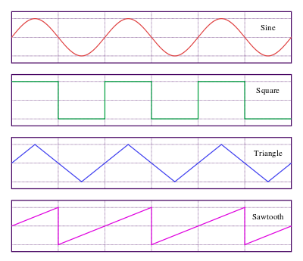
Analog vs. Digital
Analog – continuous
Digital – discrete
Digital or analog?
Mercury thermometer
Light switch
Dimmer
Vinyl record
Compact Disc
Voice telephone call
Why does everything seem to be going digital?
Quantification makes it easier to remove noise from digital signals; can recreate clean signal

Slide 7
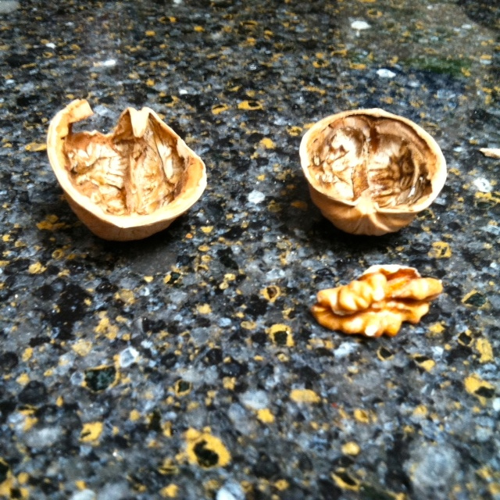
What is information?
Guessing game

Slide 8
Which shell hides the walnut piece?
Probability of correct guess = 1/2

Slide 9
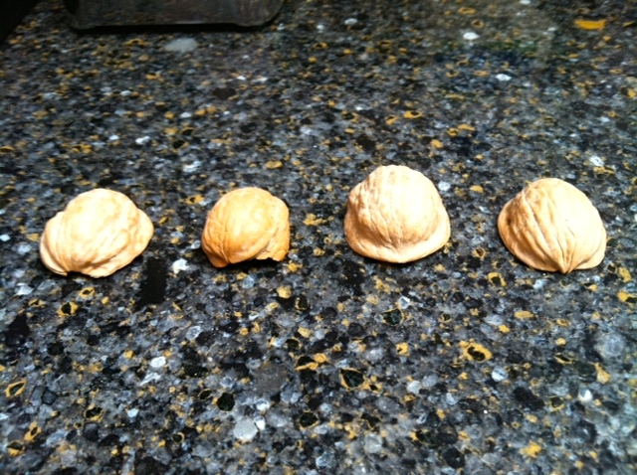
What about now?
Odds of correct guess: 1 in 4
How many guesses would you need at most?
What kind of question would you want to ask in order to ask as few questions as possible?

Slide 10
How many yes/no questions to find the prize?
For 8 objects, need 3 questions. Each question gives one bit of information

Slide 11
Eight possibilities
Information from “Is it this one?”
If “no”, you can reject 1 of 8 possibilities
If “yes”, you can reject 7 of 8 possibilities
Information from “Is it in this half of the remaining ones?”
If “no” you reject 4 of 8
If “yes” you reject 4 of 8
Suppose “no”= 0 and “yes” = 1. Question answers then in effect count the set of objects:
000 base 2 = 0 base 10
001 base 2 = 1 base 10
010 base 2 = 2 base 10
011 base 2 = 3 base 10
Actually, this is base 8 and is known as “Octal”. 7₈+1₈ = 10₈
[Note we are assuming that all positions are equally likely. If there is a bias (e.g., half the time I put the nut under shell number 7), that should change the guesses you would make]
Unequal information
Equal information
100₂ = 4₁₀
101₂ = 5₁₀
110₂ = 6₁₀
111₂ = 7₁₀

Slide 12
Sixteen possibilities
If we wanted to count to sixteen in binary, we need another bit – four bits in all
0000 base 2 = 0 base 16
0001 base 2 = 1 base 16
0010 base 2 = 2 base 16
0011 base 2 = 3 base 16
0100₂ = 4₁₆
0101₂ = 5₁₆
0110₂ = 6₁₆
0111₂ = 7₁₆
This is known as hexadecimal (base 16) and is the reason you may see (what seem to be) letters in the midst of memory dumps – you are really looking at base 16 numbers
1000₂ = 8₁₆
1001₂ = 9₁₆
1010₂ = A₁₆
1011₂ = B₁₆
1100₂ = C₁₆
1101₂ = D₁₆
1110₂ = E₁₆
0111₂ = F₁₆
Weird but true!

Slide 13
What is information? How would you measure it?
Reduction in uncertainty (~measure of surprise)
Whether it might rain (or snow!) this afternoon
Whether I received a ‘0’ or a ‘1’
Notice that the reduction in uncertainty when you receive a signal depends on how likely that signal was in the first place. If it was very likely, then receiving it is not much of surprise. If it was very unlikely, it’s a big surprise.
Term for the randomness of a distribution: Entropy
Most random distribution: uniform (hardest to predict next symbol) → maximum entropy. Examples: coinflip, dice roll

Slide 14
Information Theory
Branch of mathematics that models information transmission: (Claude Shannon, Bell Labs and MIT, 1940s)
How much information can a perfect (noiseless) channel carry?
How much information can a noisy channel carry?
Unit of information: binary digit (=bit) coined by John Tukey, mid 1940s, used by Shannon and others since
Distinguish: a bit of information vs. a bit of storage

Slide 15
Bits are just numbers, right?
Yes and no:
Numbers can represent
Letters: 0000 could be “A”, 0001 -> “B” etc.
Shades of gray: e.g., 0000 = white and 1111 = black (how many shades of gray does this encoding allow?)
Colors: (Red, Green, Blue), intensity of each as a binary number
Sounds: sound wave is acoustic pressure; quantify the pressure as a binary number, sound becomes a sequence of numbers (hence Compact Discs vs vinyl records)
Machine instructions: the elements of computer programs are machine instructions that are interpreted by the computer’s Central Processing Unit
Note that if you want to convert the numbers back into colors or sounds, you need a transducer – a printer, display screen, or speaker that can convert the numbers back into the physical dimension

Slide 16
A Little History of Telephony in the U.S.
1876: Alexander Graham Bell patents telephone
AT&T develops telephone systems
Central switching offices (manual)
1891 Strowger switch patented (first automatic switching, “step by step”)
1925: Bell Laboratories created from engineering departments
Automatic switching equipment developed
National communications networks, including hardening for national security
1940s: WWII stimulates voice encryption work “SIGSALY”
Mobile phone network of hexagonal cells proposed
1950s: Transistors and laser technologies invented
1960s: Wireless and cellular phones invented, No. 1 ESS 1965
1970s: packet switching research
1973: First consumer equipment cellular phone call
1980s: rise of (D)ARPANET
1990s: NSFNET, commercial Internet, WWW
2000s: digital convergence, VoIP, streaming, Skype, …

Slide 17
Architecture of the traditional Public Switched Telecommunications Network (PSTN) or Plain Old Telephone Service (POTS)
Circuit Switched: Effectively creates a dedicated wire path between caller and callee, as follows:
customer requests connection by dialing a number;
switching equipment locates a path to the requested number
May traverse various trunks depending on load and availability
Ring initiated at called number
Callee answers and physical path (in effect, a dedicated wire) is established between the two telephone
Voice (or other) traffic is transmitted over the path
Details are actually more complicated -- discuss
Note the distinction between the traffic and the facilities used to transmit the traffic – these are in effect different networks

Slide 18
How telephones used to work
Tandem Switch (connects trunks)
Trunk
Central office, connect up to 1000 “local loops”
Circuit switching:
Create a wire path between two telephone instruments
Hierarchical switching network
Amplifiers to regenerate signals en route
Wiretapping a circuit-switched line
Find a point anywhere on the path of the circuit (usually at central office)
Splice into the circuit
Record the traffic
“Pen Register”: record of which two telephones were connected, when, and for how long (e.g. for accounting purposes)

Slide 19
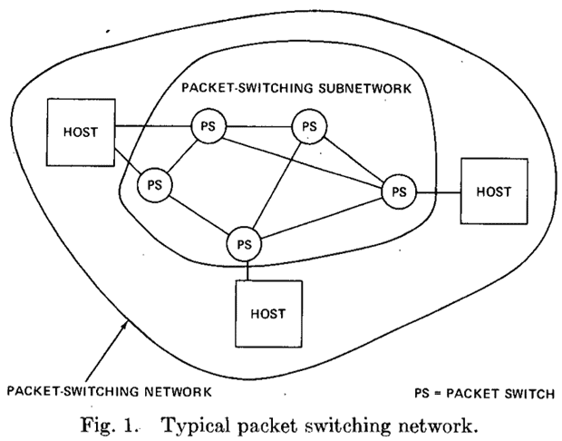
How telephones work today
Voice signal digitized at endpoint and broken into packets (fixed size blocks of bits)
Address of destination attached to packet
Packet sent into packet-switching network; different packets may take different paths through the network
From: http://www.internethalloffame.org/internet-history/timeline

Slide 20
Allocating network resources: Circuit Switching vs. Packet Switching
3
2
3
2
D
D
E
E
l
l
o
C
C
A
e
“Hello”
B
H
“Hlelo”
A
1
B
1
4
4
Circuit Switching:
Call request
Reserve dedicated “circuit” in net
Transfer information
Disconnect circuit
Low, constant delay in operation
Traffic follows one path
Potential waste of
idle allocated bandwidth
Packet Switching :
Message chopped into packets
Each node forwards packet towards destination, (dynamic routing, best effort)
Destination reassembles, re-orders, delivers to host
Deliver message to recipient
No call setup; more flexible resource use
Traffic may follow many paths, arrive out of order
“Stateless” network

Slide 21
Wiretapping a packet-switched phone call
Need a way to collect all of the packets and reassemble them
What if it’s a cellphone you want to monitor? May enter the network from many different endpoints
But cellphones identify themselves to the network and also provide valuable location data
Wiretapping may mean monitoring all the packets and just selecting those that satisfy legal warrant

Slide 22
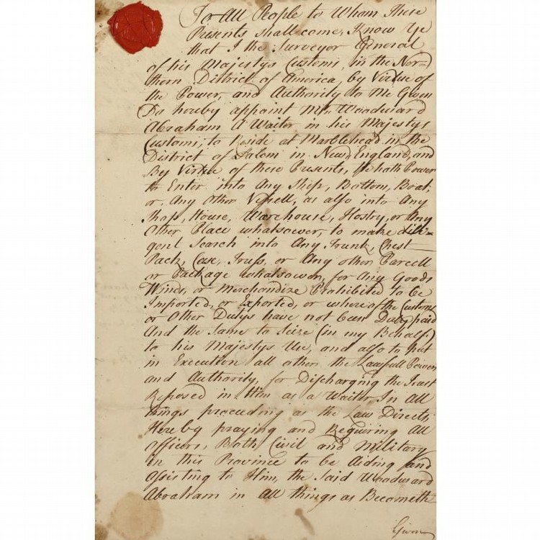
Writs of Assistance, 1760s
Smuggling was common in British American colonies in this period
Crown issued “writs of assistance” that authorized customs inspectors to search nearly anything (ship, property, household) without any further justification
Widely unpopular and fueled the Revolutionary War
This is an image of one such writ →

Slide 23
Text of a Writ of Assistance, 1762
"To All People to Whom These Presents shall come, Know Ye that I the Surveyor General of his Majestys Customs, in the Northern District of America, by Virtue of the Power, and Authority to Me Given Do hereby appoint Mr. Woodward Abraham A Waiter in his Majestys Customs, to Reside at Marblehead in the district of Salem in New-England, and
By Virtue of these Presents, He hath Power to Enter into Any Ship, Bottom, Boat, or Any Other Vessell, as also into Any Shop, House, Warehouse, Hostry, or Any Other Place whatsoever, to make diligent Search into Any Trunk, Chest, Pack, Case, Truss, or Any other Parcell or Package whatsoever, for Any Goods, Wines, or Merchandize Prohibited to be Imported, or Exported, or whereof the Customs or Other Dutys have not been Duly paid and the Same to Seize (in my Behalf) to his Majestys Use,
and also to put in Execution all other [of] the Lawfull Powers and Authority for Discharging the Trust Reposed in Him as a Waiter, In All things proceeding as the Law Directs, Hereby praying and Requiring All Officers, Both Civil and Military in the Province to be Aiding and Assisting to Him, the Said Woodward Abraham in all things as Becometh."

Slide 24
Bill of Rights, Fourth Amendment, 1791
What:
The right of the people to be secure in their persons, houses, papers, and effects, against unreasonable searches and seizures, shall not be violated, and no Warrants shall issue, but upon probable cause, supported by Oath or affirmation, and particularly describing the place to be searched, and the persons or things to be seized.
Notice:
“secure in their persons, houses, papers, and effects, against unreasonable searches and seizures”
“no warrants shall issue, but upon probable cause”
Long before the telegraph, telephone, computer
Information was manifested on paper, parchment, etc.
How would you interpret this for modern technology?
What questions are important?
3 minutes to confer
Discuss

Slide 25
Some questions to consider
In the context of modern criminal investigation involving computers and telecommunications,
What might be searched?
What might be seized?
How might a warrant be framed so as to be “particularly describing the place to be searched, and the persons or things to be seized. “

Slide 26
Charles Katz v. U.S., 1967
Katz was a Los Angeles gambler who placed bets using a public pay phone
Police installed a listening device on the outside of the phone booth, without a warrant, and evidence collected was used to convict him
Supreme Court held that “the Fourth Amendment protects people, not places”
By entering phone booth, Katz had a legitimate expectation of privacy of his utterances
Even though no trespass (an issue in placing microphones in houses, for example) was involved, this was deemed an improper unwarranted search. A warrant would have made it OK

Slide 27
Smith v. Maryland, 1978, Call Data Records (pen register)
What happened:
Phone company, at police request, but without a warrant, installed a pen register at central office to collect Smith’s call records
The call records, with other evidence, were used to obtain a search warrant, and Smith was convicted
Smith appealed on the basis that the search of the pen register lacked a warrant
Decision:
The Supreme Court held that no warrant was required because the caller had no expectation of privacy for the phone numbers called, since this information is freely provided to the phone company and constitutes a business record
Hence it is permissible for the phone company to provide this information to the police without a warrant

Slide 28
Electronic Communications Privacy Act, 1986
Responding to advances in technology, including Signaling System 7 (SS7); telephone switch that made it easier to collect CDRs
Distinguishes:
Wire communications: carrying human speech over wire, cable, or cellphone
Oral: by sound waves over the air
Electronic: any electronic communication not wire or oral (so includes email, fax
Easily intercepted (e.g., unencrypted) radio communications not protected from eavesdropping
Only a court order, not a warrant, needed for pen register. No “probable cause” demonstration required.
Stored electronic communicatons: private interception prohibited; govt interception requires search warrant for unread mail stored for 180 days or less. Contents stored longer or stored after having been read are less protected.
Also authorized “roving” wiretaps
Lecture really ended about here – will cover this and remaining slides in next lecture

Slide 29
Communications Assistance for Law Enforcement Act (CALEA) 1994
Law enforcement not satisfied with ECPA and wanting better assistance for wiretaps
CALEA required telecomm carriers to
design systems to quickly isolate call content, as well as origin/destination phone numbers
Provide this info to LE in a format and at a location of LE’s choosing
Funding provided to telecom suppliers to accomplish this
Idea was to preserve government wiretap access in new environment, not to expand it
FCC charged with overseeing implementation
Controversial; took years to implement
Extended to Internet and Voice of IP (VOIP), 2005

Slide 30
Surveillance for law enforcement vs surveillance for foreign intelligence
What differences might there be in surveillance for these different purposes?
Take 3 minutes to consider: aims, scope
Discuss

Slide 31
Foreign Intelligence Surveillance Act, 1978
Historically, President claimed authority for electronic surveillance for non-criminal, national security purposes (i.e., spying).
Abuses uncovered by Congress in 1975 prompted the passage of the Foreign Intelligence Surveillance Act (FISA) of 1978 as a means of authorizing and controlling such surveillance through warrants
FISA established that non-criminal electronic surveillances within the United States were only permissible for the purpose of collecting foreign intelligence and/or foreign counterintelligence.
FISA set up a court (FISC) whose members were public but whose proceedings were secret to authorize (or not) such surveillances proposed by intelligence organizations
FISA allowed warrantless wiretapping of communications outside the US and also communications terminating in the US if at least one party was outside the country (and this wasn’t being used as a dodge to target a U.S. person

Slide 32
USA PATRIOT Act, 2001
In the wake of 9/11 attacks, this act lowered the barriers between surveillance for national security / counterintelligence and law enforcement
Section 215 of the act enabled collection of “business records” for national intelligence purposes without a warrant.
This was thought to enable collection of individuals library records
It was used to justify NSA’s massive collection of CDRs from US telephone networks.
Legality of this collection, when it was made public, became a significant matter of public debate and legal challenge
Revisions to the Act in 2015

Slide 33
FISA Amendments Act, 2008
Warrantless wiretapping program, initiated following 9/11 attacks, was revealed by New York Times in late 2005; reportedly discontinued January 2007
Substantial doubts raised as to whether the program was legal under existing laws
FISA Amendments Act of 2008
Added a Title VII, including Section 702
Authorizes Attorney General and Director of National Intelligence jointly to authorize targeting of individuals (non U.S. Persons) reasonably believed to be outside of the U.S.
Authorized the PRISM program of which you may have heard, and some others

Slide 34
USA Freedom Act, 2015
June, 2013 Edward Snowden began releasing large volumes of classified data on NSA and GCHQ surveillance programs, evoking substantial public reaction, still ongoing
In particular, program to collect “meta-data” – CDRs of all U.S. phone calls challenged as illegal (litigation still ongoing)
Pres. Obama agreed to limit this program by having the telephone companies, rather than the government, hold this data, with the government allowed to query it under supervision
These limitations are incorporated in authorization of the program passed in the USA Freedom Act last June

